Slide 1


HOSPITAL INFORMATION MANAGEMENT SYSTEM
Free PPT Templates
Insert the Sub Title of Your Presentation

Slide 2
ABOUT THE GEMINI :
Headquartered in Ahmedabad, India, The Gemini is a leading Global Enterprise Software Provider with a reputation for Innovative Products and Outstanding Services. The company provides enterprise software solutions to multiple verticals, including Healthcare, Education, Corporate Houses, Public sector and more.
The Gemini Solutions, a leading Healthcare and Education software products provider, distributes and supports worldwide. The Gemini operations and distribution & support network for software products and solutions are spread across India , Asia, UK and US.

Slide 3

The Gemini HMS is a Hospital Management System Software designed to manage all aspects of a hospital operation. This customizable hospital management system is an integrated healthcare solution which includes Outpatient and Inpatient Management, Pharmacy, Laboratory, Radiology, Ward Management, Mobile Application, Online Appointments Scheduling, Secured Messaging, Doctor Portal, Patient and Family Portals, Medical Electronic Billing, Accounting, HR/Payroll and HL7/Integrated PACS System.
AWESOME
THE GEMINI HOSPITAL MANAGEMENT SYSTEM

Slide 4



FEATURES :
Centralized Database system
User Friendly design
Complete database Driven
Modular Structure
Improve Visibility & Transparency
Streamline Accurate Reporting
Improved Quality Control
Improved Time Management
Improved Management Visibility
Unlimited User Support
Highly secured, user wise authentication of modules
Graphical Presentation of MIS.
Effective Search Facility to Search any type of Information related to Patient.
Multiple Store Accounting.
Connect multiple branches of Hospitals. Access patient record from anywhere
Remote accession of database for instant support
Interface facility with the Smart Card Technology.
Interface with the Bar Code.
Interface with Biometric Devices

Slide 5
BENEFITS OF IMPLEMENTING A HOSPITAL MANAGEMENT SYSTEM:
APPOINTMENT BOOKING
ROLE-BASED ACCESS CONTROL
OVERALL COST REDUCTION
Helps patients cut the long queue and saves their time
Is equipped with features like automated email and text message reminders
Allows employees to access only the necessary information to effectively perform their job duties
Increases data security and integrity
Cuts down paper costs as all the data are computerized
No separate costs for setting up physical servers
DATA ACCURACY
DATA SECURITY
REVENUE MANAGEMENT
Removes human errors
Alerts when there’s a shortage of stock
Helps to keep patients records private
Restricts access through role-based access control
Makes daily auditing simple
Helps with statistics and other financial aspects

Slide 6
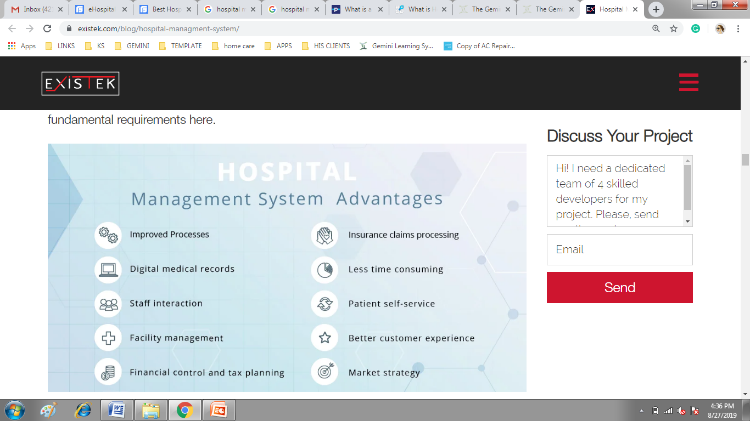

Slide 7
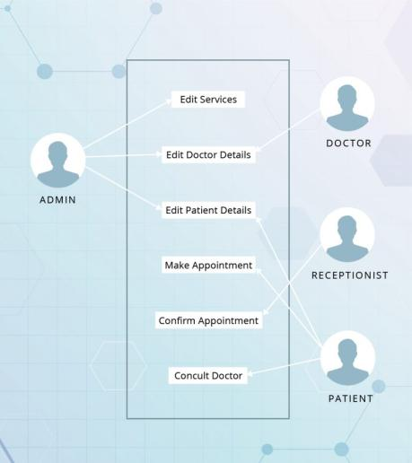
HOSPITAL MANAGEMENT SYSTEM USER ROLES

Slide 8
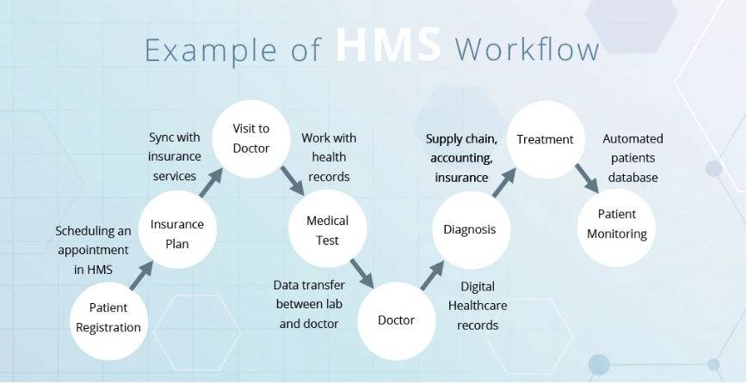

Slide 9

WHY CHOOSE US ?
A World Class Hospital Management System which is always Up-to-Date
Compliant to Standards like ICD- 10, SNOMED, RxNorm, DICOM, HL7
Patient Centric Workflows
Backed by Real-time, Dynamic Customer Support
Dedicated team members
Seamless communication with our software developers
Error free software solutions
Project delivery on fixed time
100% Client Satisfaction
24*7 Customer Support
Project Reports on time
20+ Years of experience in software solutions

Slide 10


WHAT MAKES IT UNIQUE?
HL7 and DICOM compliant
Configurable, Customizable and Modular
Seamlessly integrates with all HL7/ R232 compliant medical equipment and third party applications.
NABH and NABL Compliant
Comprehensive & dynamic MIS reporting with statistical analysis accessible remotely for better decision making.
Minimizes cost of hardware deployment by being fully functional on thin clients

Slide 11
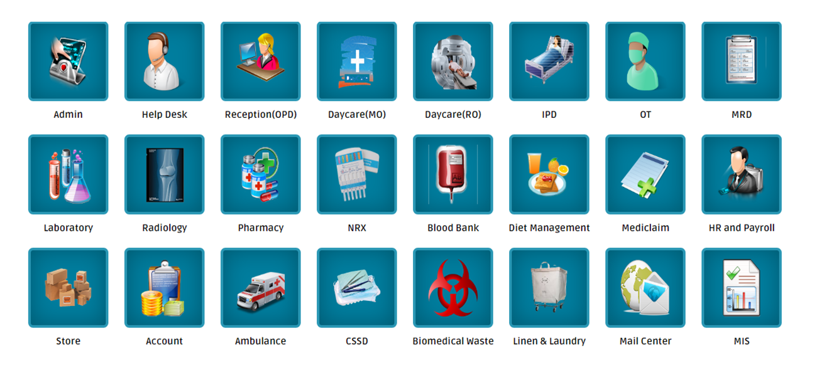
MODULES

Slide 12
OUR LOCATIONS
DEVELOPMENT CELL : AHMEDABAD, AJMER, KOLKATA
TECHNICAL SUPPORT : UDAIPUR, MUMBAI, BANGALORE, NOIDA, PUNE,KOLKATA, BHUBANESWAR
BUSINESS ADDRESS : BERLIN, GERMANY
THE GEMINI PARTNER : NIGERIA, KENYA, UGANDA, UAE, TRINIDAD

Slide 13


CONTACT US :
Phone : +91 9265562676
Skype: thegemini-india
Email: consultants@thegemini.co.in
Web: www.thegemini.co.in

Slide 14

Thank You
FOR WATCHING PRESENTATION

